Slide 1
Ashutosh Sanjay Thite
Roll No. 31462
Inhouse Internship – Big Data and Text Analytics Group, PICT.
Problem Statement 1 :
Design and Develop a recommendation system with collaborative/content/hybrid algorithm with context. Test on the accuracy and build a website/mobile application for the same.

Slide 2
Finalization of Design with Literature Survey
Week 2,3

Slide 3
Contents
Content-based Music Audio Recommendation
Music Recommendation Based on Content and Collaborative Approach & Reducing Cold Start Problem
Recommendation systems: Principles, methods and evaluation
Comparative Study of Music Recommendation Systems
Learning audio embeddings with user listening data for content-based music recommendation

Slide 4
Contents
Personalized Music Recommendation Algorithm Based on Hybrid Collaborative Filtering Technology

Slide 5
INTRODUCTION
The literature survey contains papers related to recommendation systems and music recommendation systems.
It covers content based, knowledge based and collaborative based recommendation systems.

Slide 6
Content-based Music Audio Recommendation
This paper presents ‘MusicSurfer’, which is a metadata-free system for the interaction with massive collections of music. Currently, the common ways to access music are to query by artist or song names or by using results generated by collaborative filtering. This paper uses the technology of ‘Audio Fingerprinting.’
MusicSurfer automatically extracts descriptions related to instrumentation, rhythm and harmony from music audio signals. Together with efficient similarity metrics, the descriptions allow navigation of multimillion track music collections in a flexible and efficient way without the need for metadata nor human ratings.

Slide 7
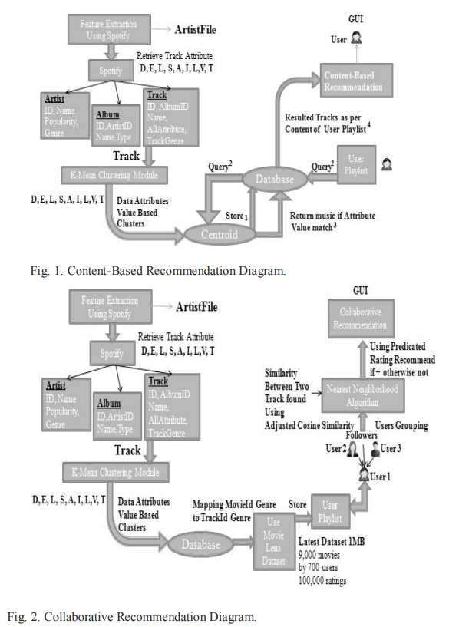
Music Recommendation Based on Content and Collaborative Approach & Reducing Cold Start Problem
In this paper, to provide music recommendation by content-based method, music subjective features Speechiness, loudness, Acoustiness etc. are analyzed. The extracted features are stored into database by using K-mean clustering algorithm. For collaborative method, rating given by user to particular music is considered and adjusted cosine similarity is used to find similarity between user-user. Once similarity found, prediction rating algorithm is used to provide recommendation to user.

Slide 8
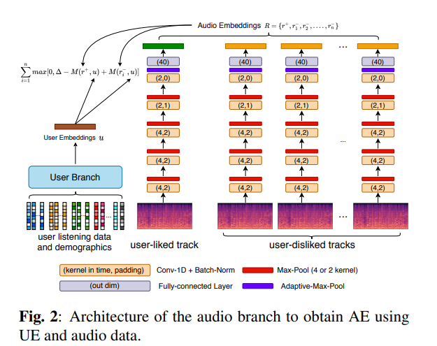
Recommendation systems: Principles, methods and evaluation
This paper explores the different characteristics and potentials of different prediction techniques in recommendation systems. It explains various recommendation filtering techniques like content-based filtering, collaborative filtering, hybrid filtering etc. and also explains different sub-topics under the filtering techniques. This paper gives an overview of the topic ‘Recommendation systems’.

Slide 9
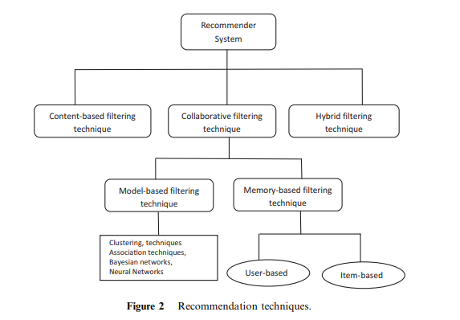
A Comparative Study of Music Recommendation Systems
The paper presents a comparative study of different music recommendation systems which are currently being used. It analyzes the Graph-based Novelty Research on the music recommendation, music recommendation systems based on the continuous combination of contextual information, context-aware personalizing for music recommendation on smart phones.

Slide 10
Learning audio embeddings with user listening data for content-based music recommendation
This paper uses user listening history and demographics to construct a user embedding representing the user’s music preference. With the user embedding and audio data from user’s liked and disliked tracks, an audio embedding can be obtained for each track using metric learning with Siamese networks. The final output gives recommendations on content based music recommendation tested with millions of users and tracks.

Slide 11
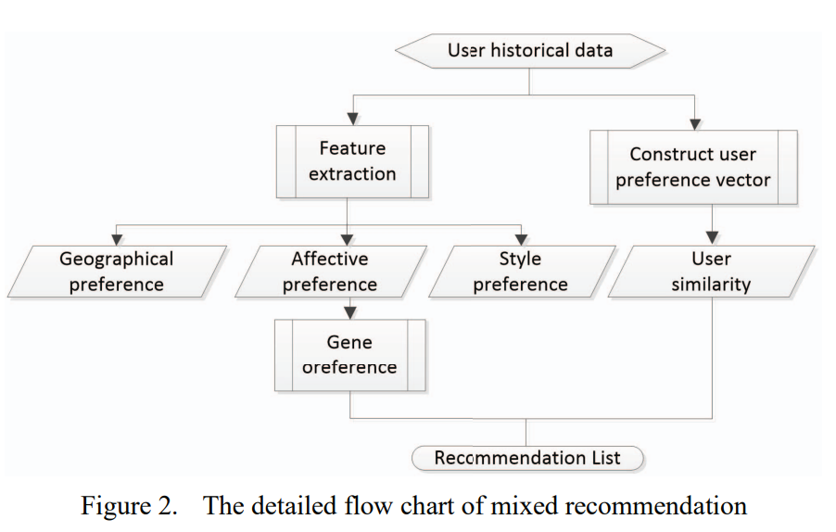
Personalized Music Recommendation Algorithm Based on Hybrid Collaborative Filtering Technology
In this paper, association rules and music genes are added to music collaborative filtering personalized recommendation system to establish a hybrid recommendation system to establish a hybrid recommendation model. The structure of the model is described, and the recommendation process and recommendation algorithm of personalized recommendation are described in detail.
The algorithm analyses users’ interest and preferences for different music gens and uses similarity of interests among different users to construct the neighborhood relationship among them.

Slide 12
References
A. Patel and R. Wadhvani, "A Comparative Study of Music Recommendation Systems," 2018 IEEE International Students' Conference on Electrical, Electronics and Computer Science (SCEECS), 2018, pp. 1-4, doi: 10.1109/SCEECS.2018.8546852.
F.O. Isinkaye, Y.O. Folajimi, B.A. Ojokoh, Recommendation systems: Principles, methods and evaluation, Egyptian Informatics Journal, Volume 16, Issue 3, 2015, Pages 261-273, ISSN 1110-8665.

